Slide 1
Competing In Today’s Lottery World
Ohio Case Study

Slide 2
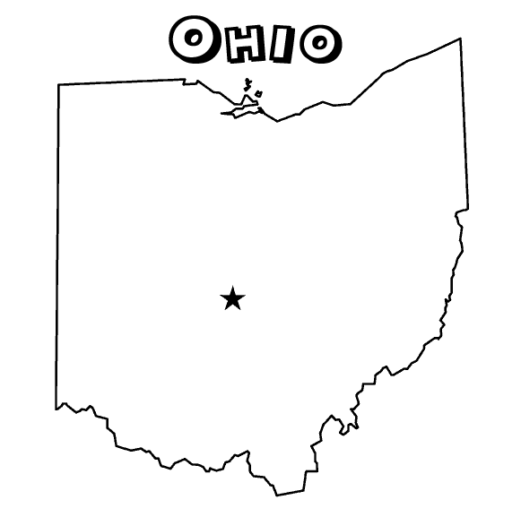
Current Competitive Landscape
4 Casinos with 8,420 machines
7 Racinos with 10,536 machines
Fantasy Sports 1 million players

Slide 3
CY15 Ohio AVG Daily Play

Slide 4
Ohio Lottery’s Reaction
Support and introduce “Social Games” in social venues
  Keno®, EZPLAY® progressive jackpot games, countdown games, EZPLAY® Tap games
  Increased the number of Self-Service Terminals
  Branded Terminals
  Expand into new or underutilized channels
  Veteran and Fraternal organizations
  Recruit, Recruit, Recruit

Slide 5

Increase
Sales from VLT’s resulted in nearly $1.4 Billion being spent at Ohio’s Racinos beginning in FY12 through FY15.
The Ohio Lottery ended FY11 at $2.6 Billion and ended FY15 at $2.9 Billion.

Slide 6
Social Games:

Slide 7

KENO State Comparison
FY11 vs FY15 KENO Sales by State (With KENO sales in both fiscal years):
State | FY11 | FY15 | Difference | PCT Change
Ohio | $ 157.9 | $ 329.3 | $ 171.4 | 108.56%
New York | $ 424.2 | $ 721.7 | $ 297.5 | 70.14%
California | $ 130.5 | $ 206.4 | $ 75.9 | 58.19%
Georgia | $ 144.3 | $ 206.5 | $ 62.2 | 43.13%
Michigan | $ 513.5 | $ 587.2 | $ 73.7 | 14.34%
Massachusetts | $ 768.2 | $ 850.6 | $ 82.4 | 10.72%
Washington | $ 5.6 | $ 5.8 | $ 0.2 | 4.49%
Oregon | $ 93.3 | $ 93.0 | $ (0.3) | -0.29%
Rhode Island | $ 81.1 | $ 80.5 | $ (0.6) | -0.69%
D.C. | $ 11.5 | $ 10.4 | $ (1.1) | -9.92%
Missouri | $ 65.3 | $ 58.4 | $ (6.9) | -10.57%
Maryland | $ 380.6 | $ 303.0 | $ (77.6) | -20.38%
W. Virginia | $ 6.4 | $ 5.1 | $ (1.3) | -20.60%
Kansas | $ 24.1 | $ 18.2 | $ (5.9) | -24.33%
Overall | $ 2,806.4 | $ 3,476.1 | $ 669.7 | 23.9%
US Online sales increased 7.15% from FY11 vs FY15.
Ohio Online sales increased 17.80% from FY11 to FY15

Slide 8
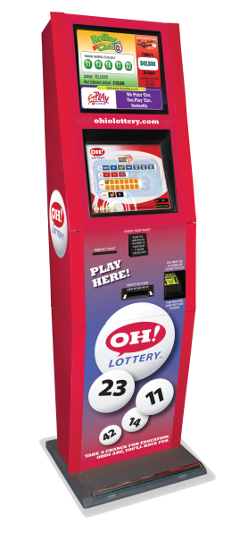

Notable Sales Milestones
      KENO sales surpassed Pick 3 as the top selling online game in CY15
        MP KENO sales accounted for 63% of total CY15 KENO sales
      so far in 2016.
      MP Sales to exceed $1B since July 2009
      Industry leader in Instant Terminal Games
        EZPLAY® CY15 sales over $107 Million

Slide 9
Increased Vending Footprint:

Slide 10
Vending – OH WinStations CY09-CY15
Install Base increased from 1422 to 2078
Average Daily Sales (ADS) per WinStation
  increased from $355 to $403
Total Sales - $1.5+ Billion

Slide 11
Vending – OH MPs CY09-CY15
Install Base increased from 493 to 2518
Average Daily Sales (ADS) per MP
  increased from $62 to $294
Total Sales - $900+ Million

Slide 12
New Channel,
New Game:

Slide 13

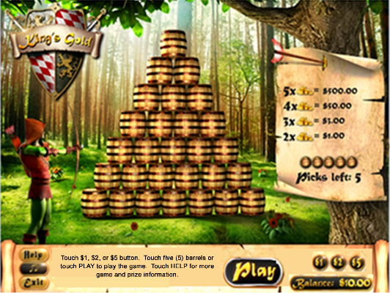
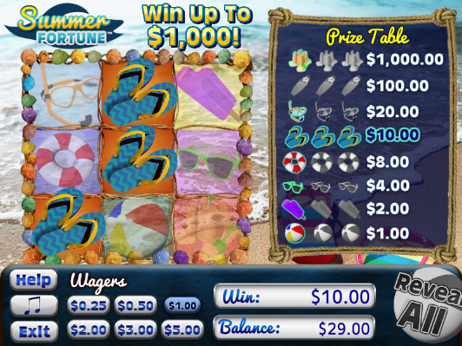
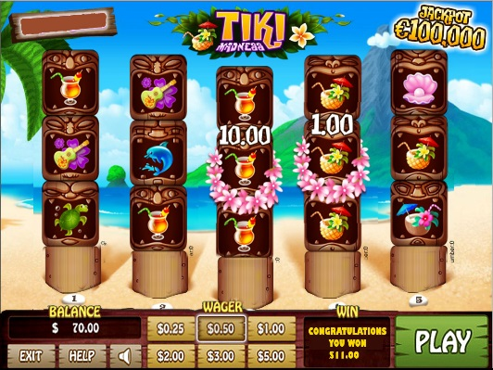
EZPLAY® TAP Games
EZPLAY® TAP games are interactive, predetermined, instant win, Lottery games played on self-service terminals through a touch screen interface.
  Sold only in veteran and fraternal clubs

Slide 14
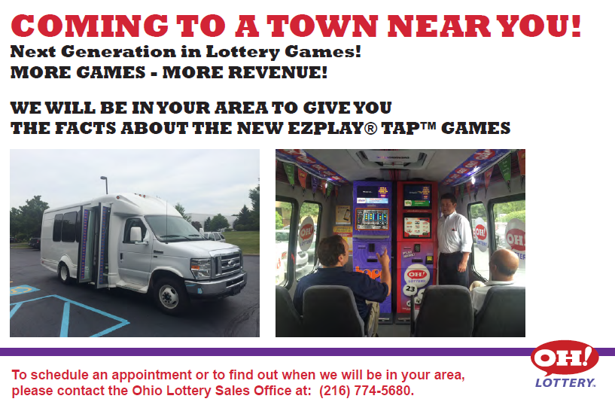
Retailer Recruiting
Made it easy!

Slide 15
Performance
EZPLAY Tap® launched Oct. 2014 in Vets & Frats
Validations range from 83%-85% due to
  higher payout
Total Sales - $47 Million

Slide 16
Looking Ahead:

Slide 17
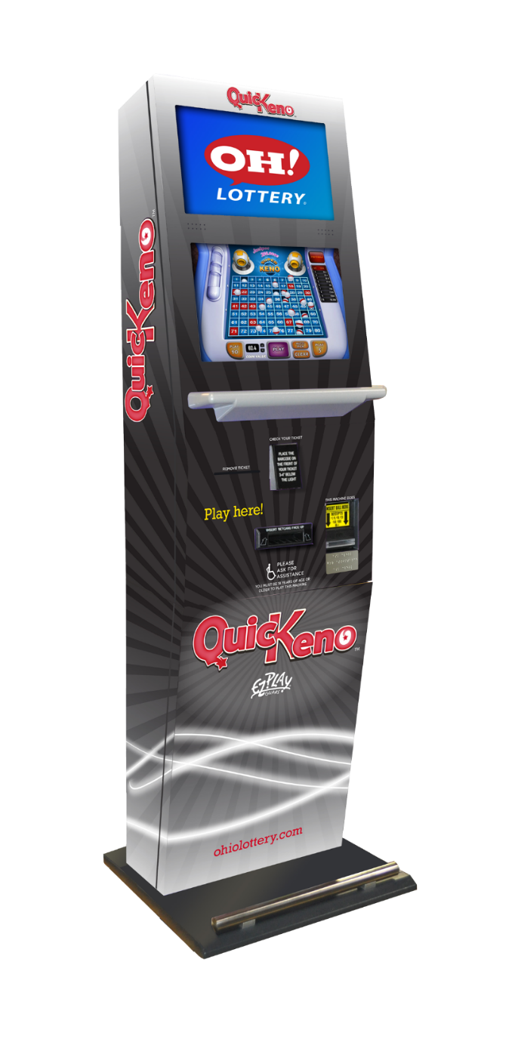

QuicKeno Branded Machine
QuicKeno™ branded terminal helps differentiate the games played on this terminal compared to similar terminals
    Colors and themes designed in collaboration with OLC
    Complements terminals already in the field
      Venues could have terminals working in concert without looking like banks of the same cabinet as in a casino
    Differentiates and focuses on content delivery
      Allows Players to focus on specific gameplay associate with specific hardware*
      *all games can still be played on the terminal

Slide 18
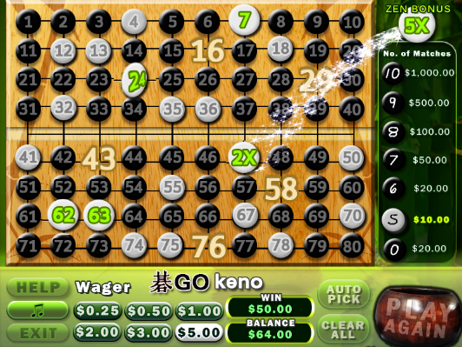
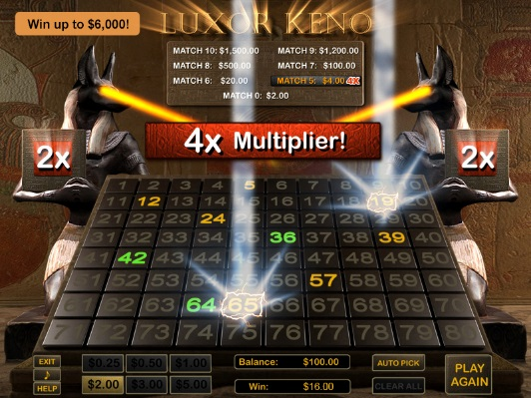
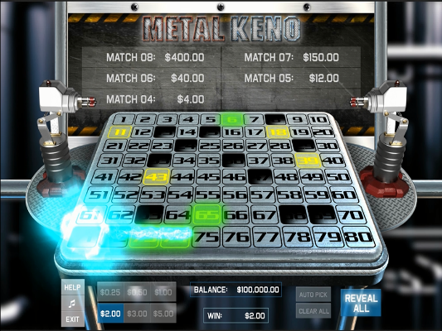
QuicKeno Games
QuicKeno: Interactive Keno games played on branded self-service terminal
    Planned Release: June, 2016

Slide 19

THANK YOU

